Slide 1

I-Access Search Program
A learning Project submitted by
Monalisa Prusty
31 July 2021

Slide 2

TABLE OF CONTENT
Welcome Screen
Create Data Module
Create Data Confirmation
Search Data Module
Search Result Display
Search Result – Page Transition
Thank You

Slide 3
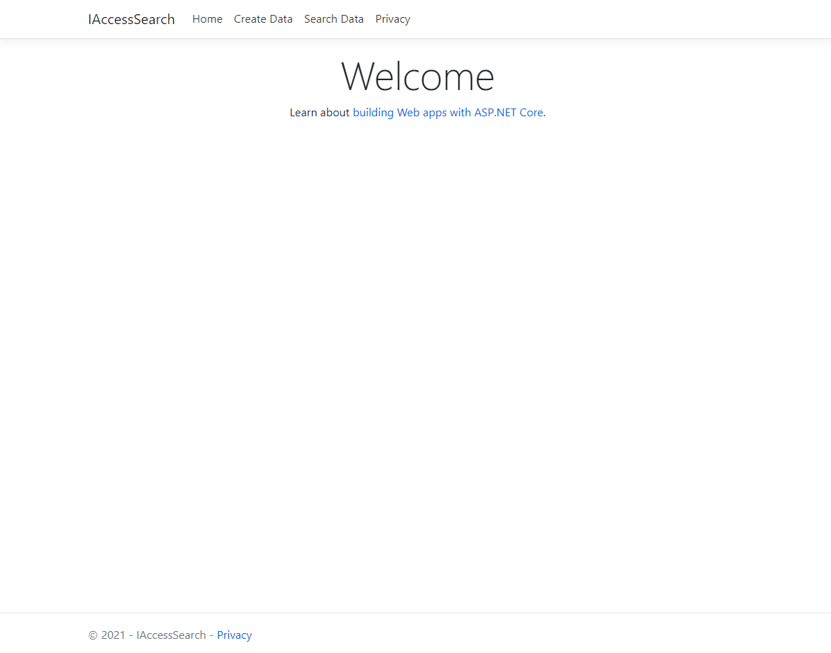
Screen to show the first page with Menu links to
Create Data
Search Data

Slide 4
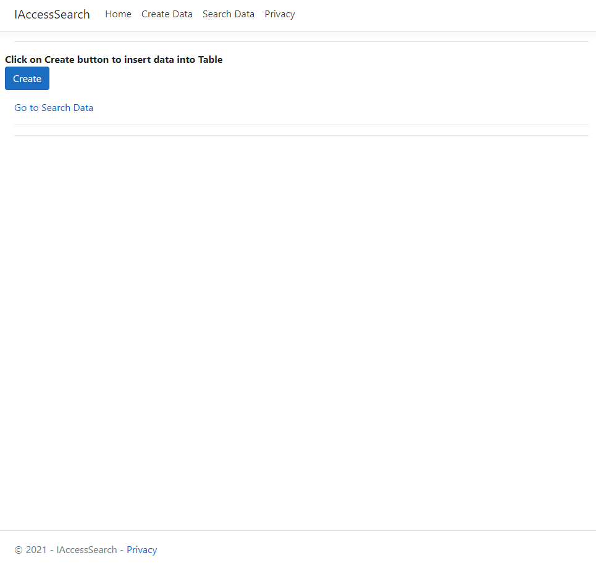
Clicking on “Create Data” navigation, the screen shows the button to create the sample date

Slide 5
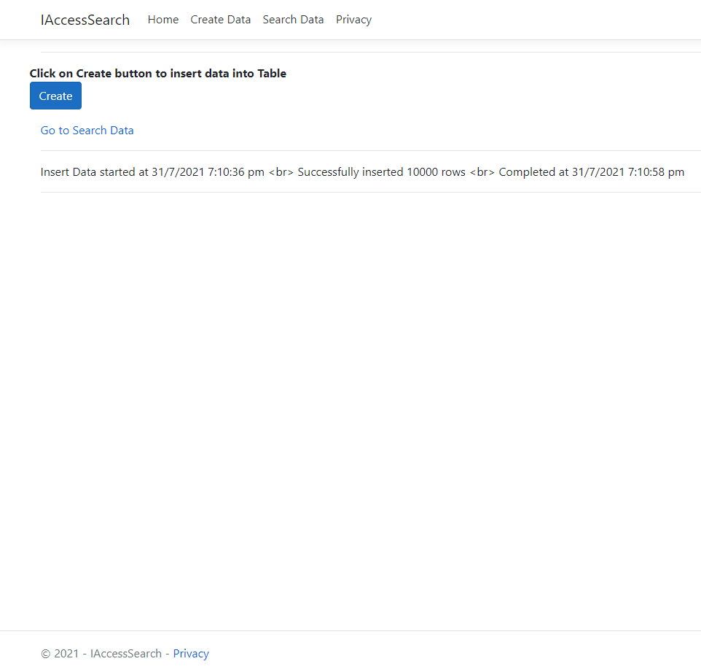
Once the button is clicked, the program starts creating the sample data with below specs –
Key – Created with random characters and 5 parts separated by hyphen, all UPPER CASE
Content – Created by random alphanumeric characters, with length between 1000 to 2000, all lower case.
Once completed, the result shows the start time, end time and how many records created.

Slide 6
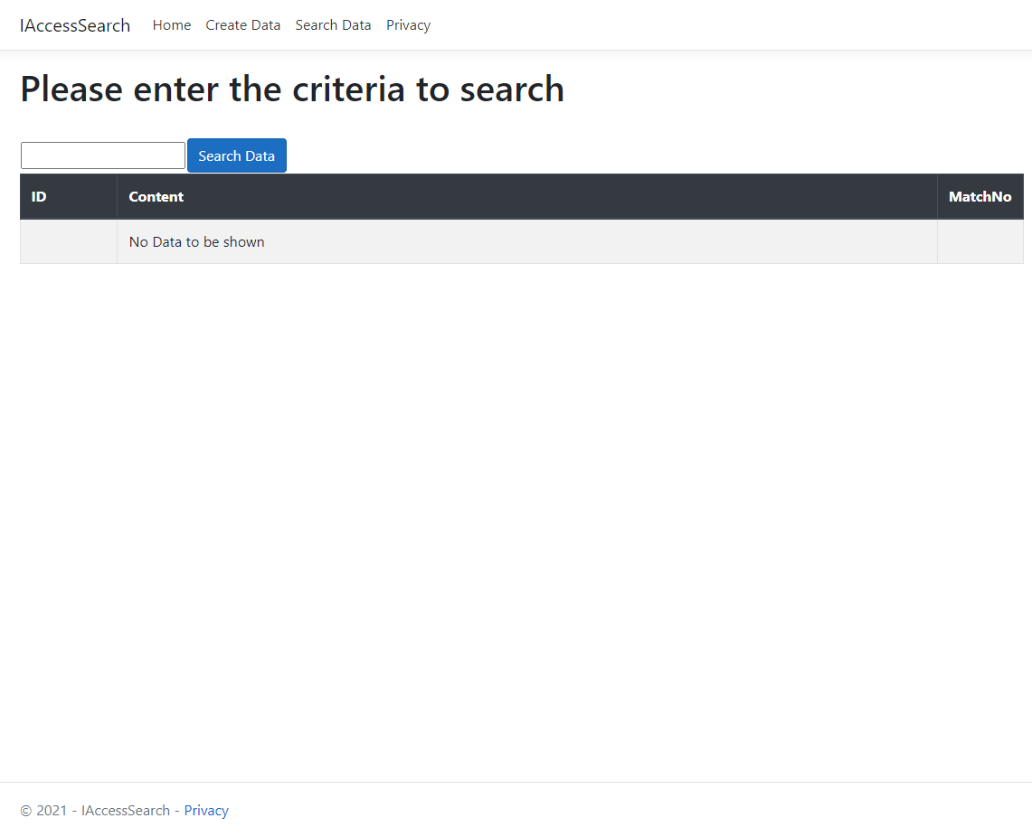
Screen showing initial Search page.
Enter search characters in the text box and click on “Search” button to find the matching data.
When nothing is searched, the grid shows the message “No Data to be shown”

Slide 7
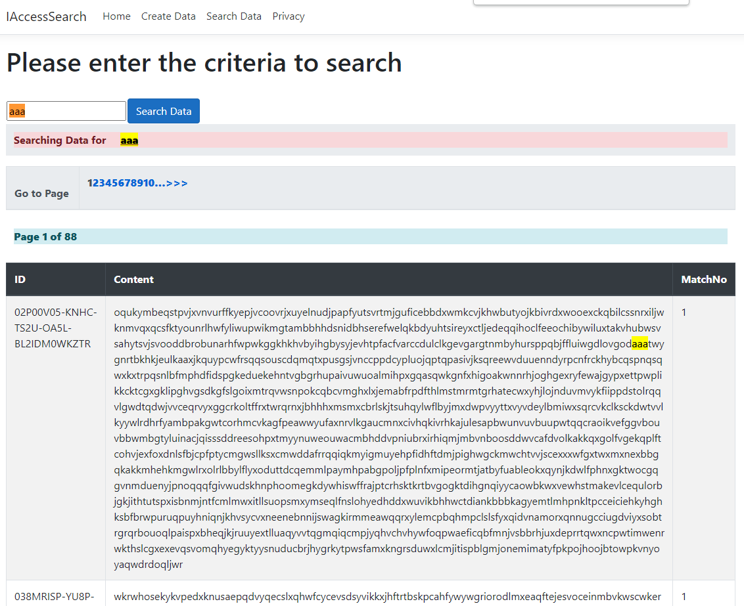
Screen showing searched data matching with the characters.
The last column “Match No” shows how many times the searched characters appears in the text.
For easy navigation, the page numbers are shown with current page number. Users can jump into any page directly by clicking the page link.

Slide 8
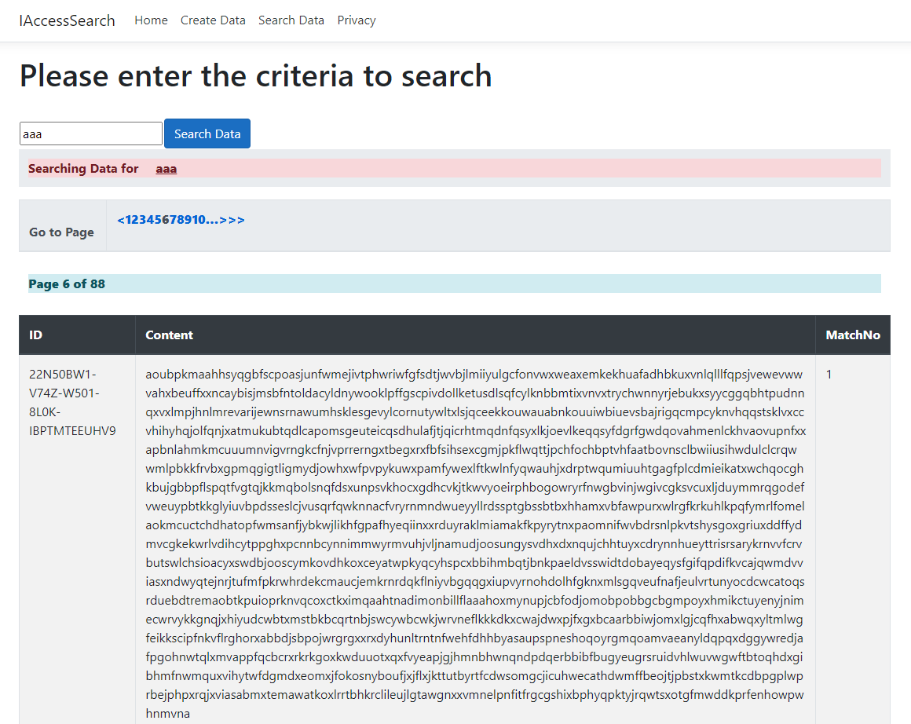
Screen showing searched data on 6th Page.

Slide 9
The complete sample code is available in public GIT folder
https://github.com/monalisa-prusty/I-AccessSearch

Slide 10
THANK YOU

